Slide 1
G D 2 1 0
Game Studio

Slide 2
Team Contracts / Contribution Agreements

Slide 3
Prototypes / Updates

Slide 4
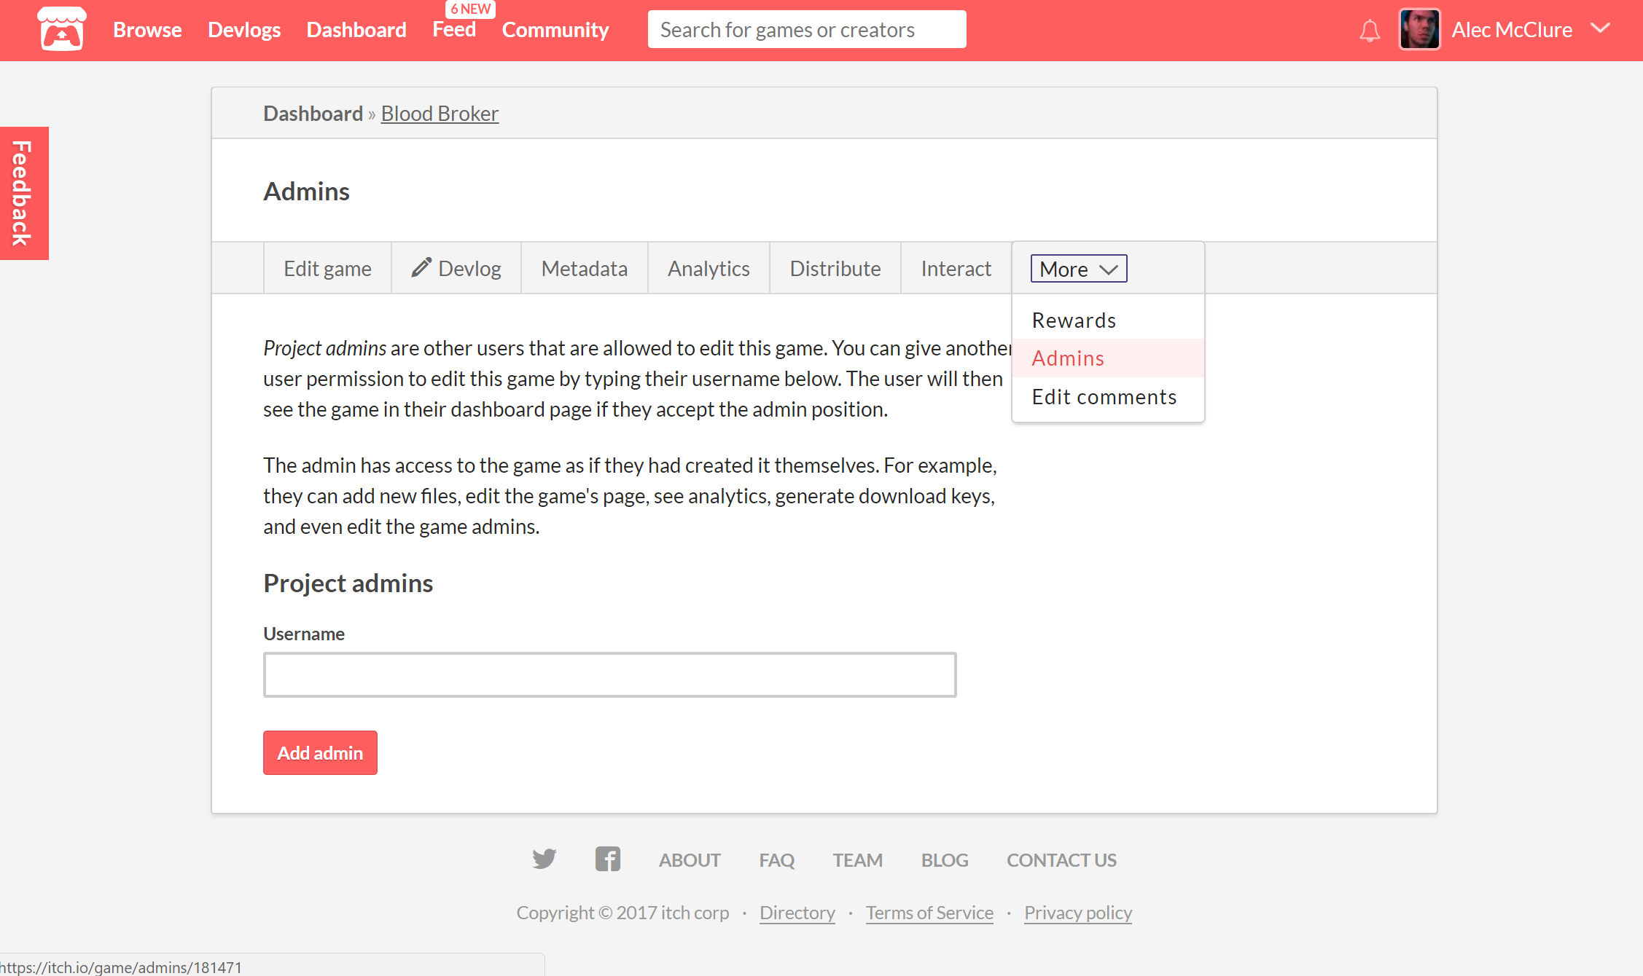
itch.io Team Projects and Devlogs
Each team member should be an admin so they can post devlogs.

Slide 5
Last week...

Slide 6

PREVIOUS
ASSIGNMENT
Meaningful Play (RoP)
Reading:
RR4:
Write a paper relating the reading to your studio’s project. min one-page (approx. 400 words)
Notes:
meaningful play…
accountability
branching rpg storylines
disappointment and story arcs that never went anywhere, choices that went unaddressed
at the heart of play lies the attempt to find a solution, meaning, etc.
without feedback, we dont know how we are doing, we cant try something new, experiment, get better

Slide 7
Video Game Market
Notes:
What do we know about videogames?
For whom are they for?
Who plays video games?

Slide 8
Global Game Market
2005 US - $10.3 billion
2014 - $83.6 billion
( 2014 US - $22.41 billion )
2015 - $91.8 billion
2016 - $99.6 billion
2017 - $107 billion

Slide 9
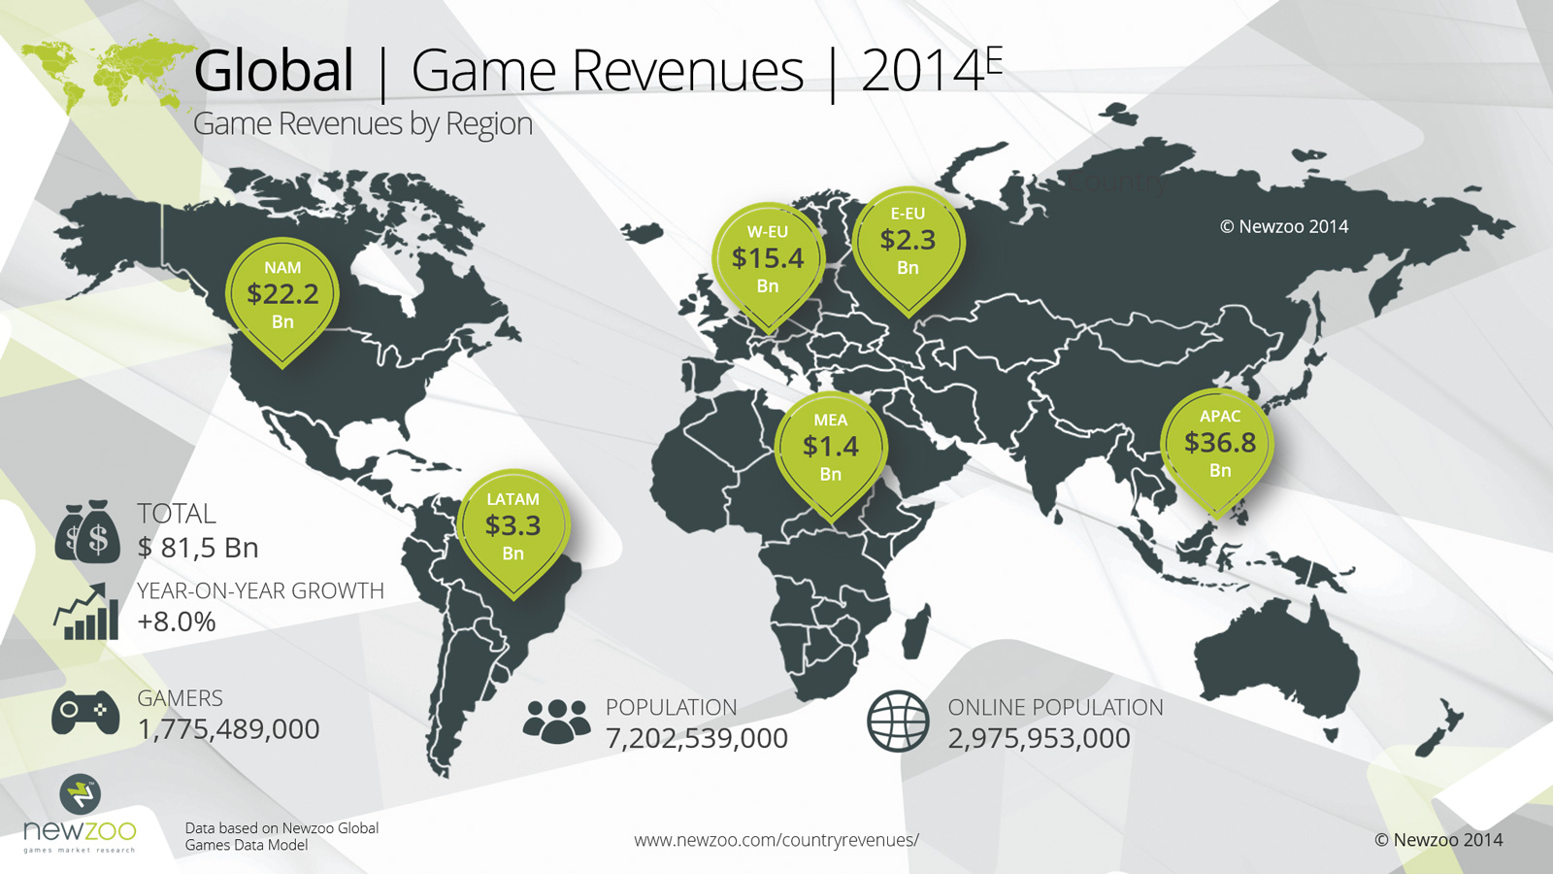

Slide 10

59% of Americans play video games

Slide 11
“People of all ages play video games. There is no longer a ‘stereotype game player,’ but instead a game player could be your grandparent, your boss, or even your professor.” —Jason Allaire, Ph.D., associate professor of psychology at North Carolina State University and co-director of the Gains Through Gaming Lab

Slide 12
Average Gamer Age?

Slide 13

Average Gamer Age:
37 (2011)
31 (2014)
35 (2015)
according to Entertainment Software Association

Slide 14
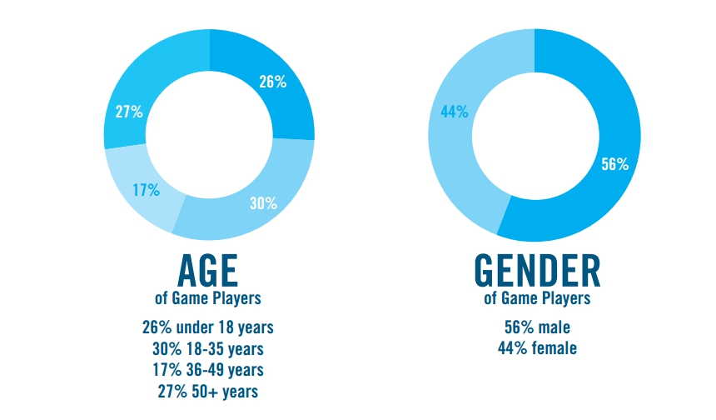
52% Male
48% Female
Notes:
for americans from esa report

Slide 15
TOP DEVICES MOST FREQUENT GAMERS USE TO PLAY GAMES:
PC (62%),
DEDICATED GAME CONSOLE (56%),
SMARTPHONE (35%),
WIRELESS DEVICE (31%),
DEDICATED HANDHELD SYSTEM (21%)

Slide 16
Women in Games
52% gamers
12% game designers
3% programmers
according to the IAB (Internet Advertising Bureau UK)

Slide 17
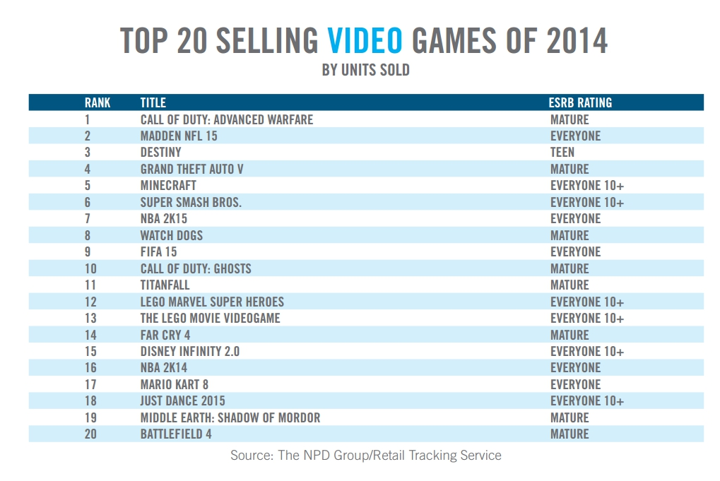

Slide 18
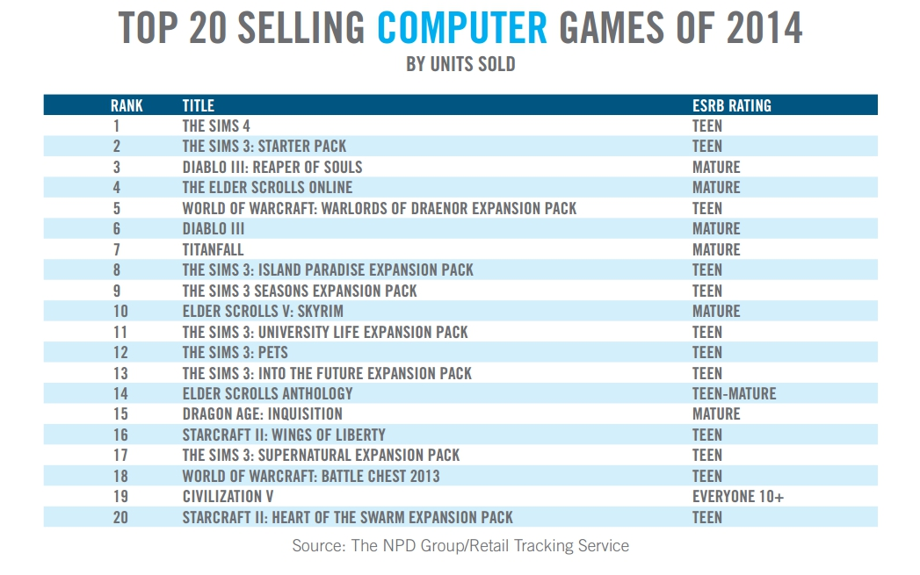

Slide 19
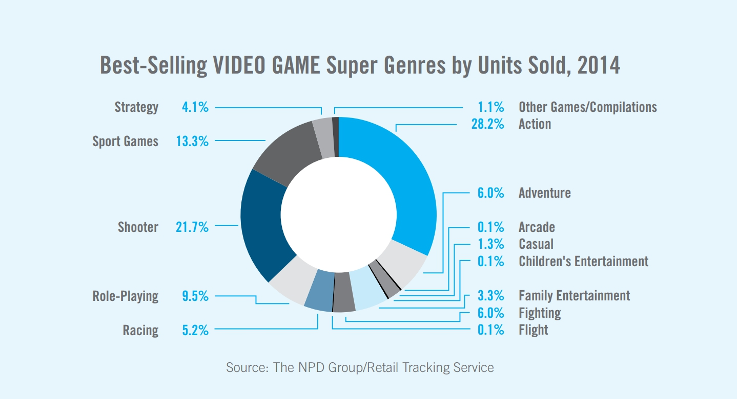

Slide 20
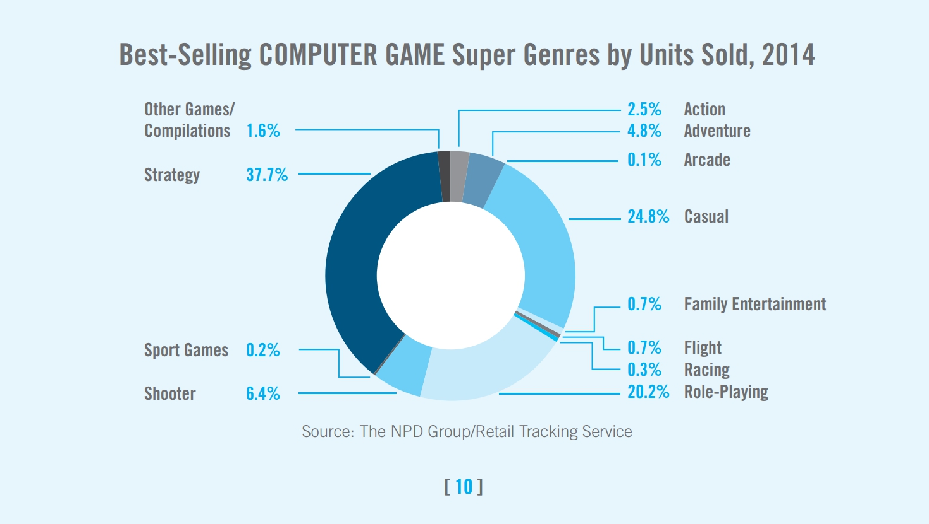

Slide 21
COMPARISON
Notes:
Why are computers better suited for strategy and role playing games

Slide 22

WHICH COMPANY HAS THE HIGHEST GAME REVENUE?

Slide 23

Companies by Game Revenue
Tencent $10.2b
Sony $7.8b
Activision Blizzard $6.6b
Microsoft $6.4b
Apple $5.9b
EA $4.6b
https://newzoo.com/insights/rankings/top-25-companies-game-revenues/

Slide 24
Position Salaries
via Gamasutra survey 2014

Slide 25
Programmers: $71,855
Artists and animators: $50,000
Game designers: $53,000
Producers: $59,079*
Audio professionals: $95,682**
Quality Assurance: $38,833
EARLY CAREER
Notes:
Audio no entry level and small sample

Slide 26
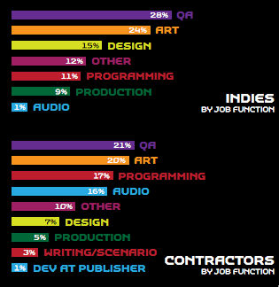

Slide 27

Solo Indie Dev. Salary
$11,812

Slide 28
Indie Dev. Team Member Salary
$50,833

Slide 29

Indie Income from Crowdfunding
5%
2012 source: http://www.appsblogger.com/kickstarter-infographic/

Slide 30
Total funding success rate
43%
2012 source: http://www.appsblogger.com/kickstarter-infographic/

Slide 31
Avg. successful project goal
$5,487
2012 source: http://www.appsblogger.com/kickstarter-infographic/

Slide 32
Avg. failed project goal
$16,365
2012 source: http://www.appsblogger.com/kickstarter-infographic/

Slide 33
“Fifty-seven percent of indie game developers (including both solo indies and members of indie teams) made under $500 in game sales. On the other end of the spectrum, 2 percent made over $200,000 in game sales.”

Slide 34
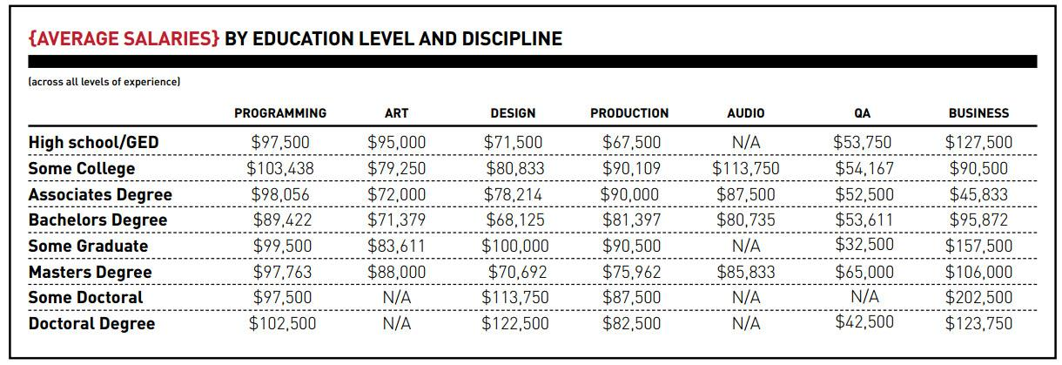

Slide 35
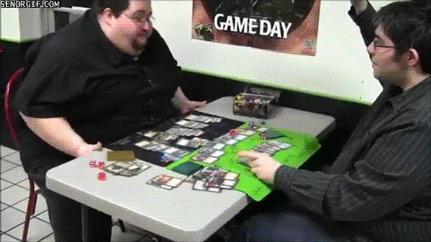
Average Salary
Men $85,074
Women $72,882

Slide 36
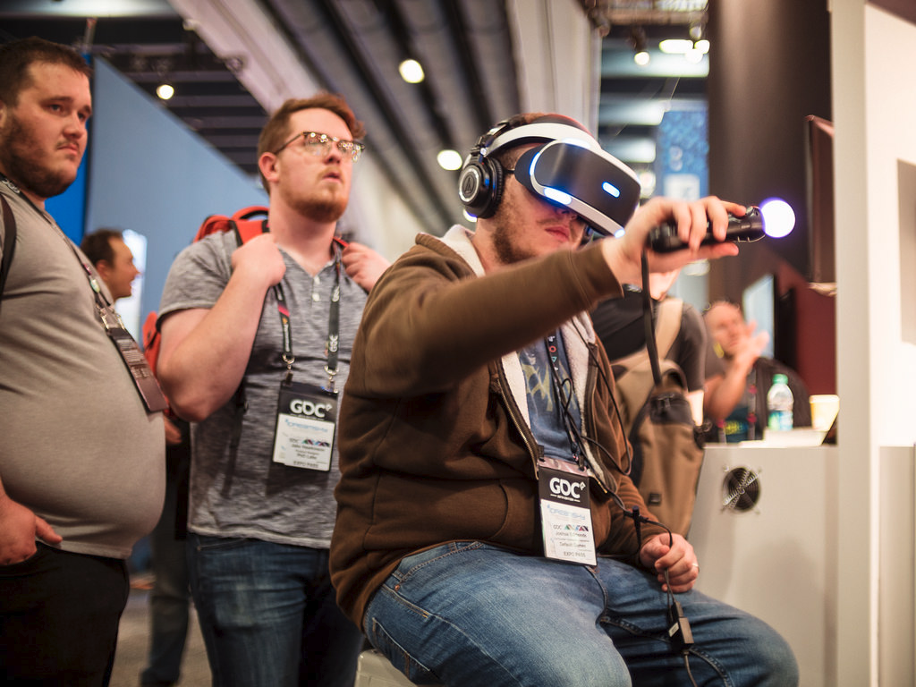
TOP CONFERENCES, EXPOS & EVENTS
Game Developers Conference, San Francisco in March
PAX, Seattle in August
(PAX East, Boston in April)
E3, Los Angeles in June
IndieCade, Los Angeles in October
(IndieCade East, NYC in April/May)

Slide 37


Slide 38


Slide 39
Best way to get into games?
MAKE GAMES

Slide 40
Do you have a respectable website/online portfolio?

Slide 41
“Passion and experience still carry a lot of weight in the game industry. Everyone should have a portfolio to show in interviews. But if you are leaning towards being a software engineer I do highly recommend getting a bachelors in computer science. [...] A great portfolio might overrule this requirement but it is a great fall back.”
-- Allison Salmon, game developer and software engineer, Learning Games Network, ex-Raven Software

Slide 42
“When I hire developers, experience, attitude and portfolio are far more important than what - or if - you chose to study as a teenager.”
--Paul Taylor – co-founder, Mode7 Games

Slide 43
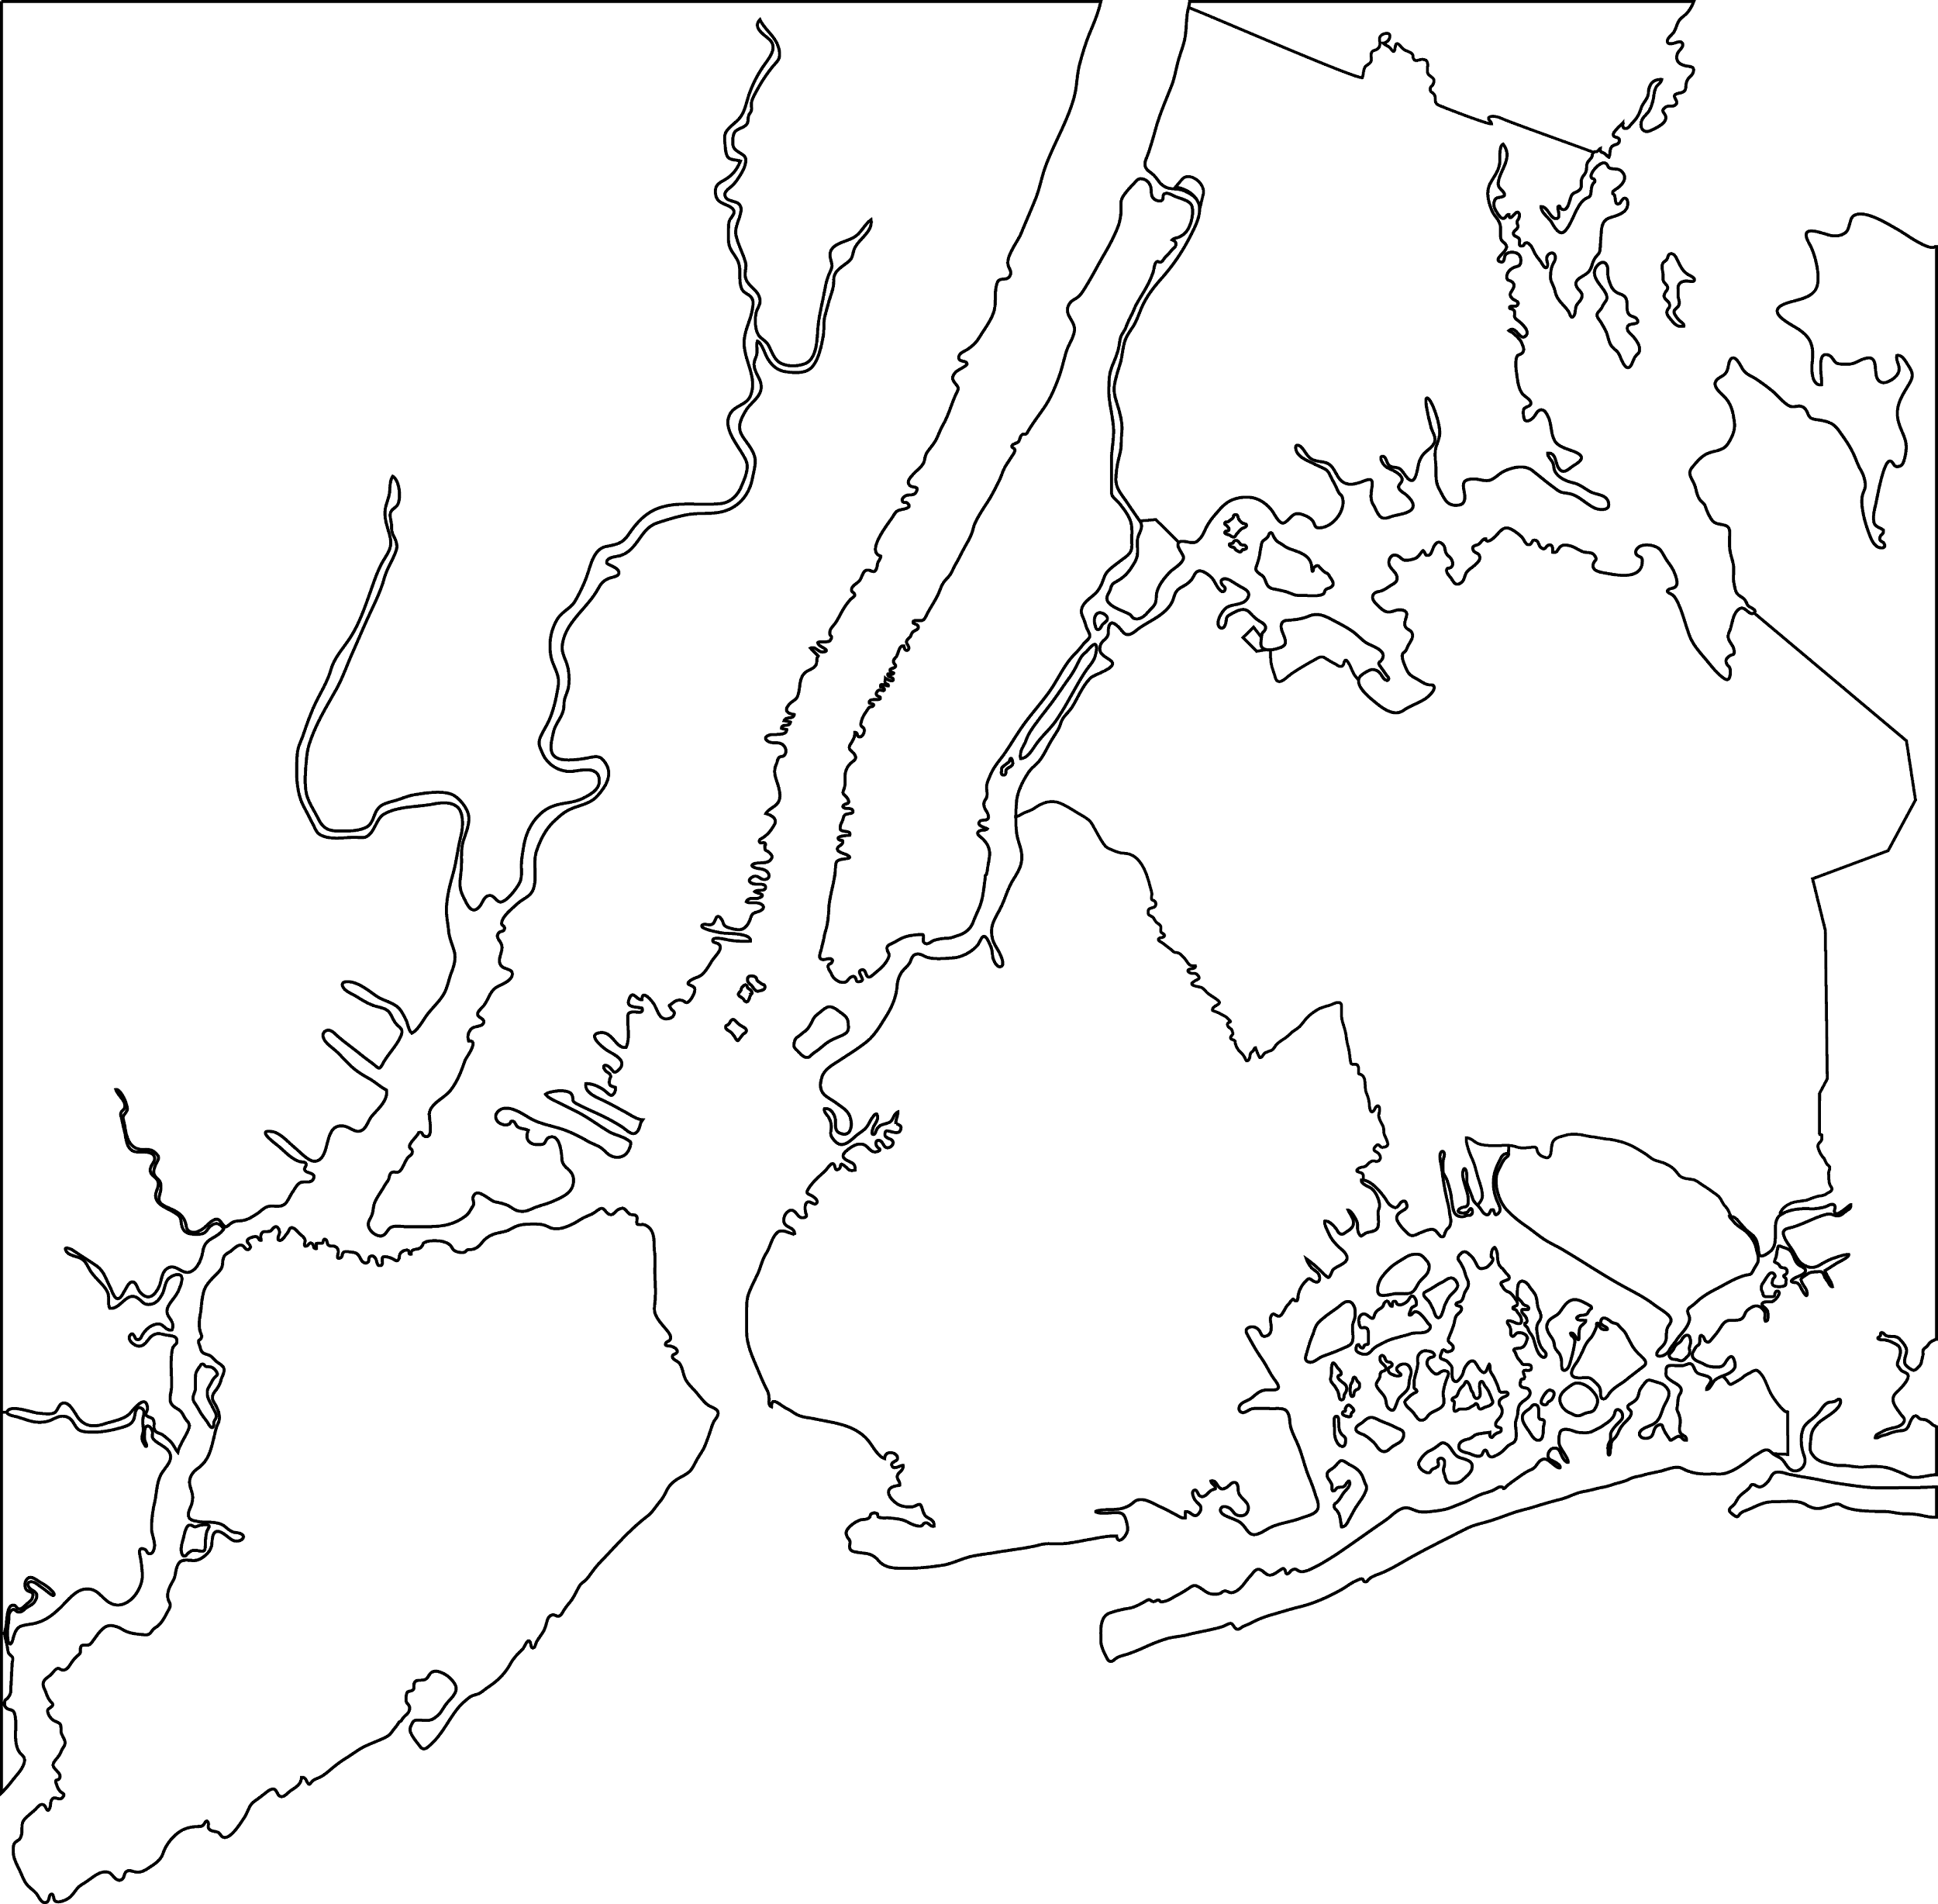
NYC Area Game Programs
12 programs
Notes:
Since we are a 2 year program, students are constantly asking where they should transfer to continue studying games.
Depending on how you define it, there are around 12 game education degree programs in the NYC metro.

Slide 44
NYC Area Public Game Programs
Hostos
City Tech
Brand new!
2 programs
Notes:
Now limit that to just public schools and you have Hostos and 1 other one, a brand new concentration at City Tech.

Slide 45

Does Game Design / Dev Education Matter?
Notes:
So we may be asking ourselves, why not just study Computer Science or another field with a proven track record in the industry?

Slide 46

YES
Game Education Matters
Notes:
So, YES, game education matters.
I often tell my students in my code classes that my first foray into code was a CS class in high school that I failed.
For many, games and interactive development are the only available path to learn fundamental technical skills.
If not for game classes, there are many students that would otherwise be falling asleep learning the Fundamentals of Computer Science. [point at self]

Slide 47
Public School Bachelor’s Game Programs
CUNY - City Tech
http://www.citytech.cuny.edu/entertainment/emerging-media-btech.aspx#
SUNY Canton - BS Game Design & Development http://www.canton.edu/csoet/game/description.html
SUNY Poly - BS Interactive Media & Game Design
https://webapp.sunypoly.edu/stories/faculty-profile-ibrahim-yucel/
https://sunypoly.edu/academics/majors-and-programs/interactive-media-game-design-imgd.html

Slide 48
Private Options
Long Island University
Brookville, NY
Degree(s) Offered: Master
Dowling College
Oakdale, NY
Degree(s) Offered: Bachelor
Canisius College
Buffalo, NY
Degree(s) Offered: Bachelor
Adelphi University
Garden City, NY
Degree(s) Offered: Bachelor
The College of New Jersey
Ewing, NJ
Degree(s) Offered: Bachelor
Stevens Institute of Technology
Hoeboken, NJ
Degree(s) Offered: Minor, Bachelor, Master
Rutgers University – New Brunswick
New Brunswick, NJ
Degree(s) Offered: Bachelor
Fairleigh Dickinson University – Florham Campus
Teaneck, NJ
Degree(s) Offered: Bachelor
Bloomfield College
Bloomfield, NJ
Degree(s) Offered: Certificate, Minor, Bachelor
Stony Brook University (public; game programming concentration)
Stony Brooke, NY
Degree(s) Offered: Bachelor
Rochester Institute of Technology
Rochester, NY
Degree(s) Offered: Bachelor, Master
Rensselaer Polytechnic Institute
Troy, NY
Degree(s) Offered: Bachelor
Nyack College
New York, NY
Degree(s) Offered: Bachelor
New York University
New York, NY
Degree(s) Offered: Minor, Bachelor, Master
New School
New York, NY
Degree(s) Offered: Bachelor, Master
Marist College
Poughkeepsie, NY
Degree(s) Offered: Bachelor

Slide 49
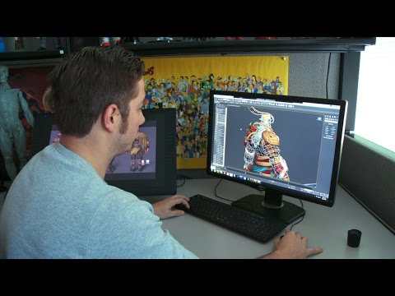

Slide 50

DUE DATES
Weekly Devlogs 04.xx.18
GDD 05.01.18
Alpha Build + Presentation Outline 05.08.18
Beta build due 05.15.18
Final Game + Documentation 05.22.18
Hostos Arcade Presentations 05.22.18

Slide 51

ASSIGNMENT
Read:
WDL:
Game:
What do Prototypes Prototype?
Submit your individual Weekly Dev Log, including the Playtesting Report and analysis (approx. 400 words)
Second prototype showing look and feel
Recommend starting with a mood board and then moving into prototypes (example)

